Slide 1
Financial Services Procurement and Payment Services
Purchasing & Payment Fundamentals
September 19, 2014
Training Objective
Provide an introductory overview of the University’s policies and procedures for purchasing and payment of goods and services.

Slide 2
Agenda
1
Purchasing and Payment within the University
2
Policy Overview
3
Purchasing Methods at the University
4
Purchasing Ethics
5
Useful Websites
6
Help References
7
Additional Training Opportunities
2

Slide 3
University Overview for Purchasing and Payment Activities
Center-Led Model
Department Heads
Authorized to make purchase order commitments up to $25k
Ensure University procedures are followed for all departmental purchases
Local Business Centers (LBC) & Auxiliaries
Reside within some (not all) campus units
Responsible for local purchasing and payment transaction processing
Delegated Procurement Centers
Some specific functional areas have formal delegated authority to negotiate/contract on behalf of the University (e.g. – Facilities, HR, etc)
Delegations are issued to recognize specific functional expertise
Procurement and Payment Services
Resides within the Financial Services unit of Finance & Administration
Responsible for University-wide policy, procedures, systems & strategy
Provide University-wide support and oversight for large transactions
Transactional processing for campus units without internal processing capabilities

Slide 4
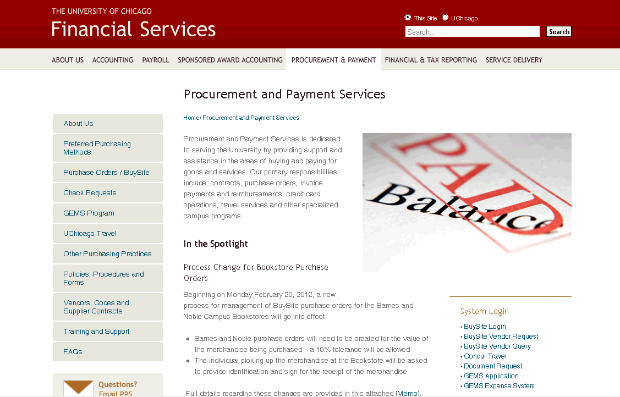
Procurement and Payment Services
http://finserv.uchicago.edu/purchasing/index.shtml

Slide 5
Agenda
1
Purchasing and Payment within the University
2
Policy Overview
3
Purchasing Methods at the University
4
Purchasing Ethics
5
Useful Websites
6
Help References
7
Additional Training Opportunities

Slide 6
Procurement and Disbursements Policy Overview
Policy | Policy Name
1201 | Authority and Responsibility for Procuring Goods and Services
1202 | Travel Policies and Procedures
1203 | Approval of Non-Payroll Expenditures
1204 | Non-Audit Services by University Auditors
1205 | Minority-Owned, Women-Owned, and Small Business Enterprises Procurement Policy
1206 | Gifts to Other Not-for-Profit and Charitable Organizations
1207 | Institutional Membership Fees and Dues
1208 | Individual Professional, Business and Technical Organization Membership Fees and Dues
1209 | Membership Fees and Dues for Social, Dining, Airline and Hotel Clubs
1210 | Parking Fees
1211 | Gifts Based on University/Employee Relationships
1212 | Gifts to Non-Employees
1213 | Authority to Lease, Buy, and Sell Real Estate
1214 | Non-Salary Cash Advances
1215 | Retention of Outside Legal Counsel
1216 | Authority for Settlement of Workers’ Compensation and Liability Claims
1217 | Donor and Volunteer Gift Policy
http://finserv.uchicago.edu/support/policies/

Slide 7
Policy 1201 Highlights
The Executive Vice President for Administration and Chief Financial Officer is vested with the responsibility for the procurement of all goods and services
The Executive Director of Procurement and Payment Services and Associate Vice President for Finance are responsible to establish and maintain policies and procedures
All University procurement policies shall be in compliance with Federal regulations for procurement standards (OMB Circular No. A-110)
Certain officers and departments have been delegated Procurement Authority (Procurement Centers)
The Executive Vice President for Administration and Chief Financial Officer has final signature approval for all purchases in excess of $200,000
Department Heads have authorization to issue University purchase orders up to $25,000 through BuySite
The University will reimburse individuals for business related expenses (non-travel) up to $500

Slide 8
Delegated Procurement Centers
Position | Description of Goods or Services | Maximum Signature Authority Per Transaction
Associate Vice President for Finance | Accounting and Banking Services | $100,000
Associate Vice President, Facilities Services | Contracts for construction and renovation | $5,000,000
Associate Vice President, Facilities Services | Contracts for all other goods and services, management services, rentals, and maintenance contracts | $200,000
Director, Residence Halls and Commons | Construction, renovation, maintenance, equipment, food services and furnishings for assigned residence hall and commons areas | $100,000
Chief Information Officer | Information Technology related goods and services | $200,000
Director, Library | Books, publications and related items | $100,000
Director, University Press | Printing and related supplies/services, marketing/advertising for publications | $200,000
Director, Laboratory Schools | Books, supplies, athletic clothing, food services | $100,000
Assistant Vice President for Risk Management and Audit | Liability, property and related insurance coverages | $100,000
Associate Vice President for Human Resources | Personnel and Benefits Services | $100,000

Slide 9
Agenda
1
Purchasing and Payment within the University
2
Policy Overview
3
Purchasing Methods at the University
4
Purchasing Ethics
5
Useful Websites
6
Help References
7
Additional Training Opportunities
9

Slide 10
Purchasing Channels at the University
Purchasing Channel | General Usage
Catalog Purchase Order (processed in BuySite) | Commonly purchased goods or services PPS has established catalogs in BuySite
Non-Catalog Purchase Order (processed in BuySite) | General purchase order items not available in a BuySite catalog
Manual Purchase Order (use Purchase Form 100) | Request contract creation/review Establish Blanket or Standing Orders
Check Request (processed in ePayment) | Payment vehicle for various non-PO items After-the-Fact Channel (already have invoice)
Travel/Procurement Card Purchases (reconciled in the GEMS system) | Travel Expenses Low $ Business Expenses
Employee Out-of-Pocket Expenses (reconciled in the GEMS system) | Not a preferred method Policy 1201 limits to $500 and below
P.O. Channels
Non-P.O. Channels
Visit the Preferred Purchasing Methods matrix on the Financial Services
website for guidance on the proper Purchasing Method to use

Slide 11
What is a Purchase Order?
A purchase order is a form of contract
It contains terms and conditions of sale that protect the University
A purchase order is used to procure goods and services and authorizes a supplier to begin work – it is created “Before-the-Fact”
It is generated based upon a pre-approved requisition
Provides a single reference number (PO number) to relate all billing to for the University and supplier
Enables the ability to match resulting invoice with originally agreed upon pricing
11

Slide 12
General Purchasing Guidelines
Treat purchases as if spending your own money – compare sources, prices, time of delivery, references from other users at the University
If not comfortable in making a spending decision – engage someone from your LBC, a Procurement Center or PPS
Documentation requirements for Purchases:
Purchases <$5k – Item description and price documentation
Purchases $5k - $25k – Price Reasonableness must be documented
Purchases >$25k – PPS must be engaged
Use the University Preferred Supplier Contracts when purchasing common items – the cost analysis and price justification are already done for you

Slide 13
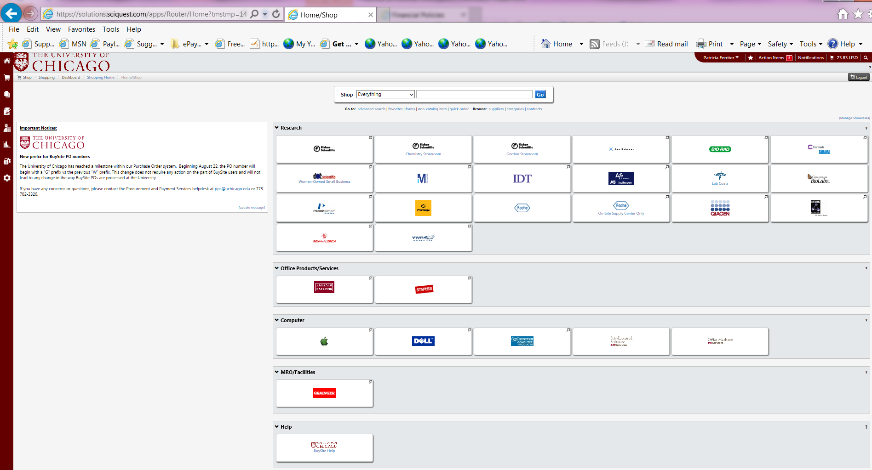
BuySite Catalog Purchase Requisitioning
BuySite Purchase Orders – PO with numbering format Gxxxxxx

Slide 14
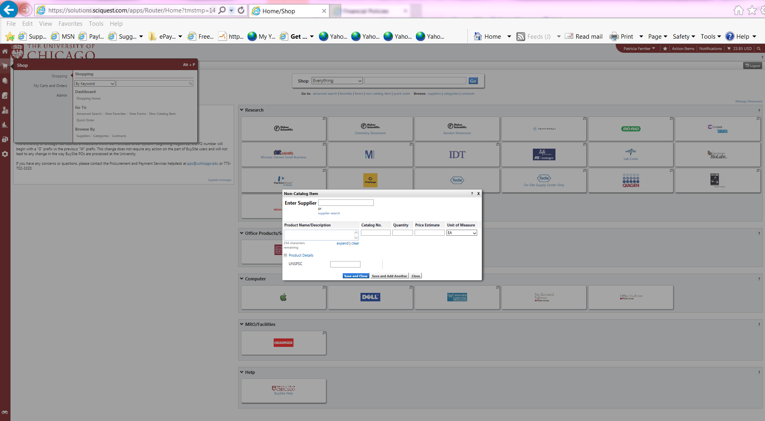
BuySite Non-Catalog Purchase Requisitioning
BuySite Purchase Orders – PO with numbering format Gxxxxxx

Slide 15
Purchase Request Form 100
Purchase Form 100 Purchase Orders – PO with numbering format Uxxxxxx

Slide 16
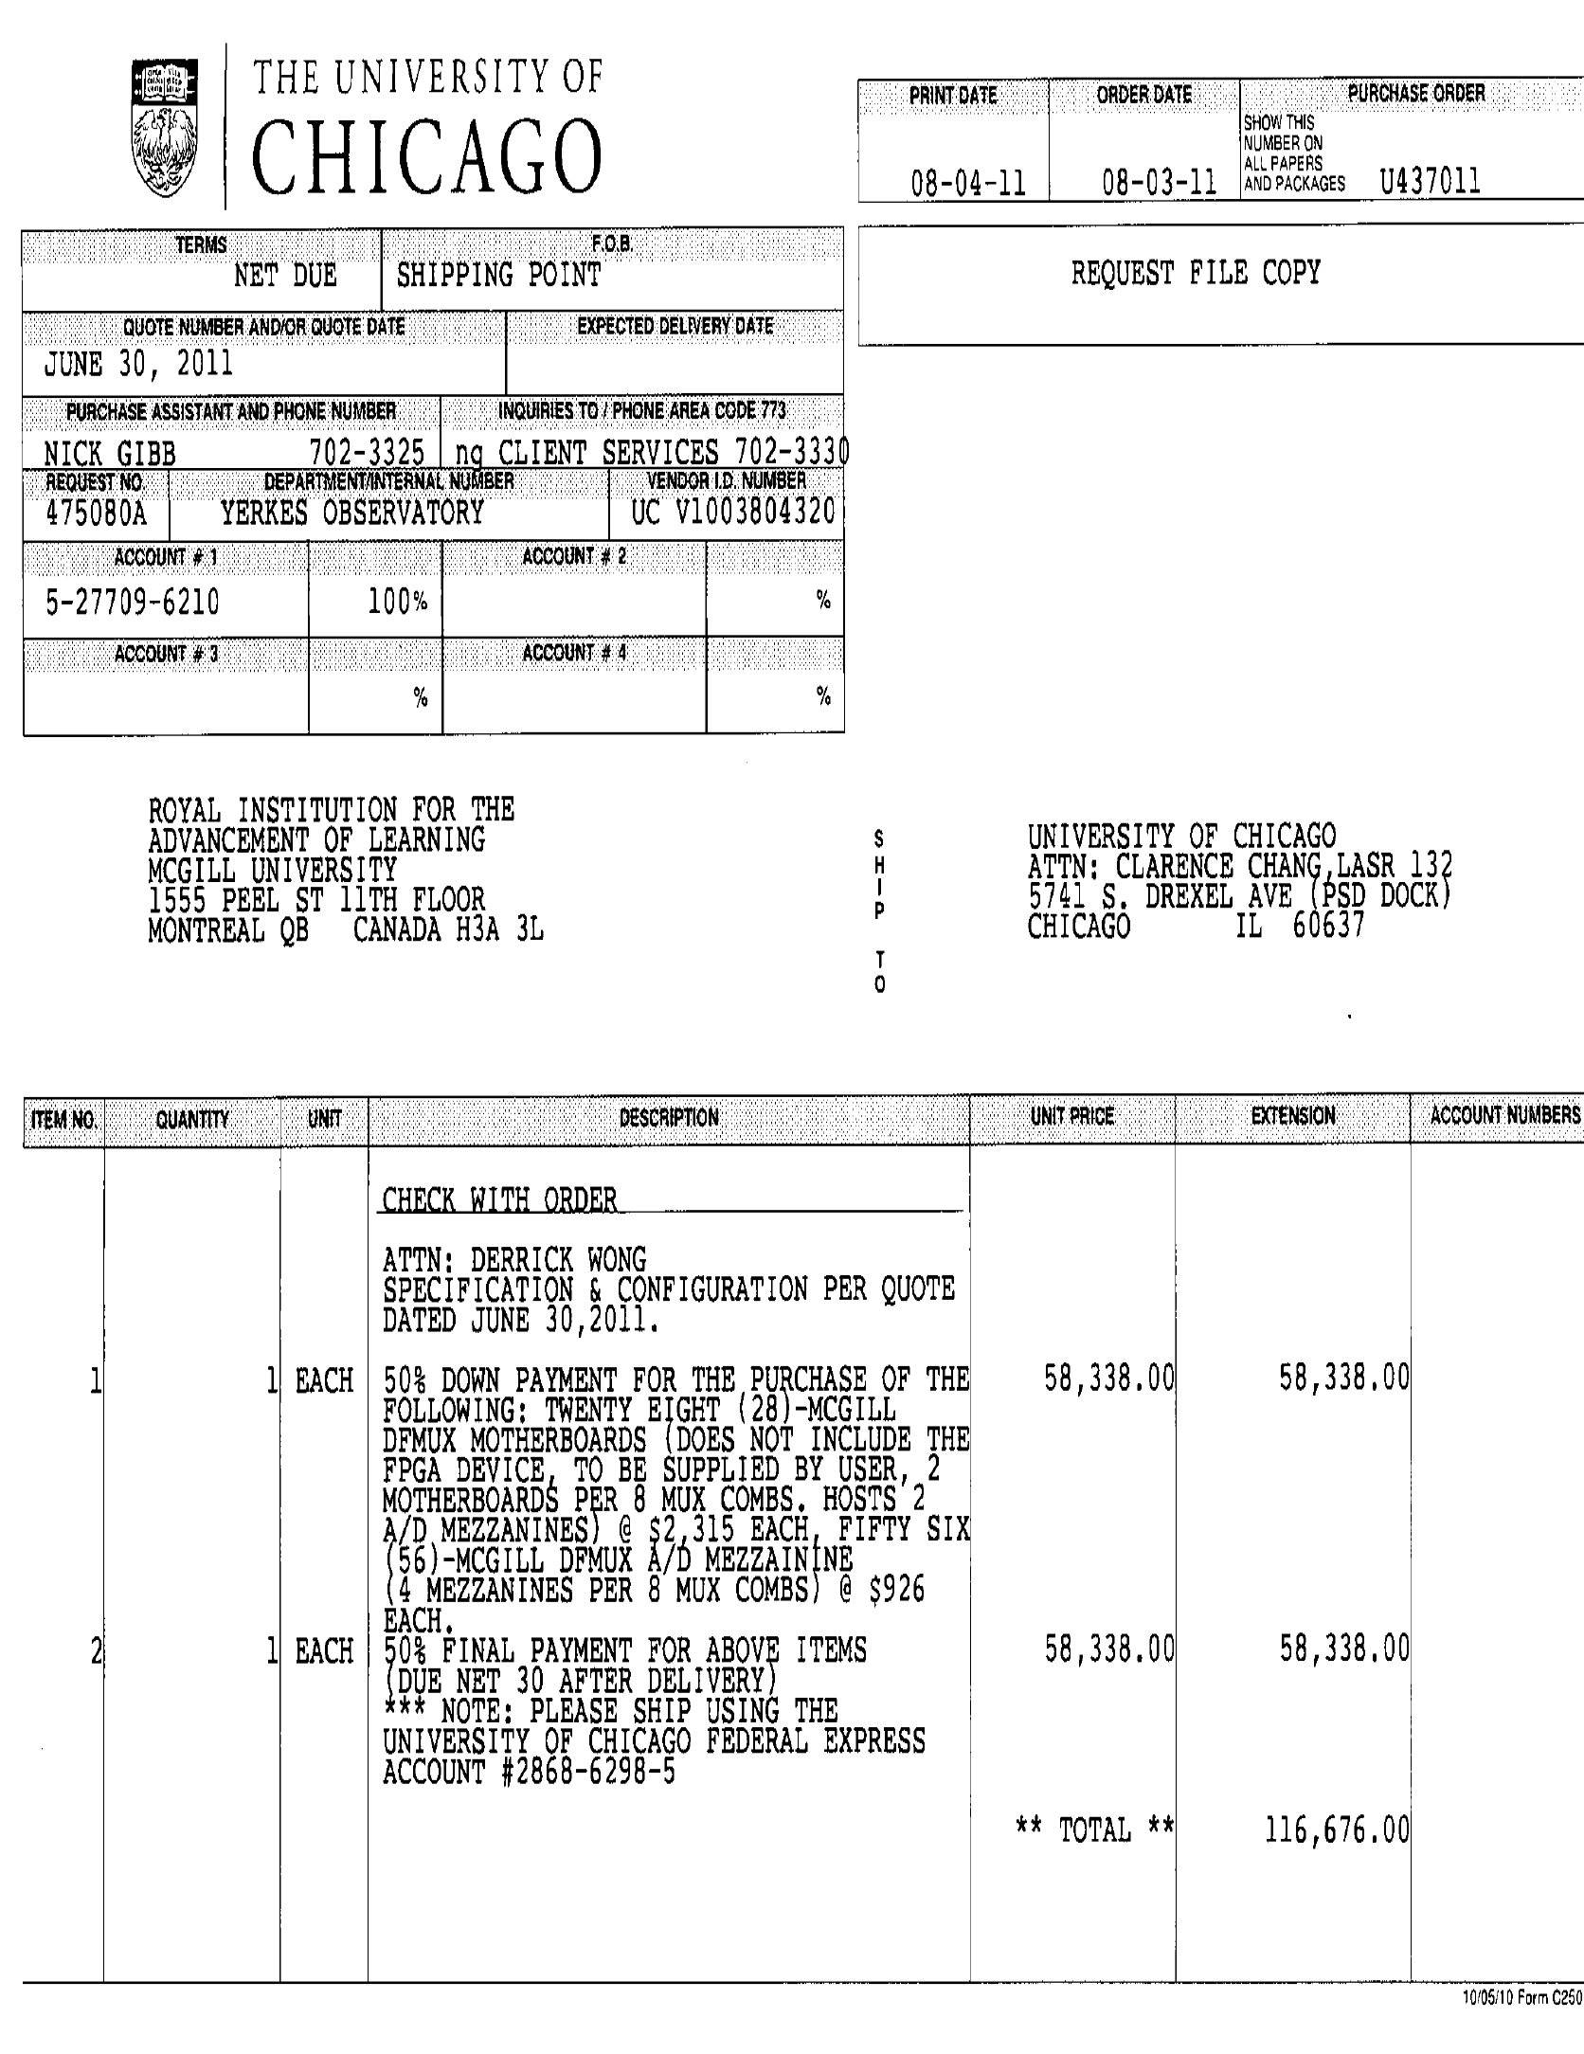
Example of a Manual Purchase Order (Front - Internal)

Slide 17
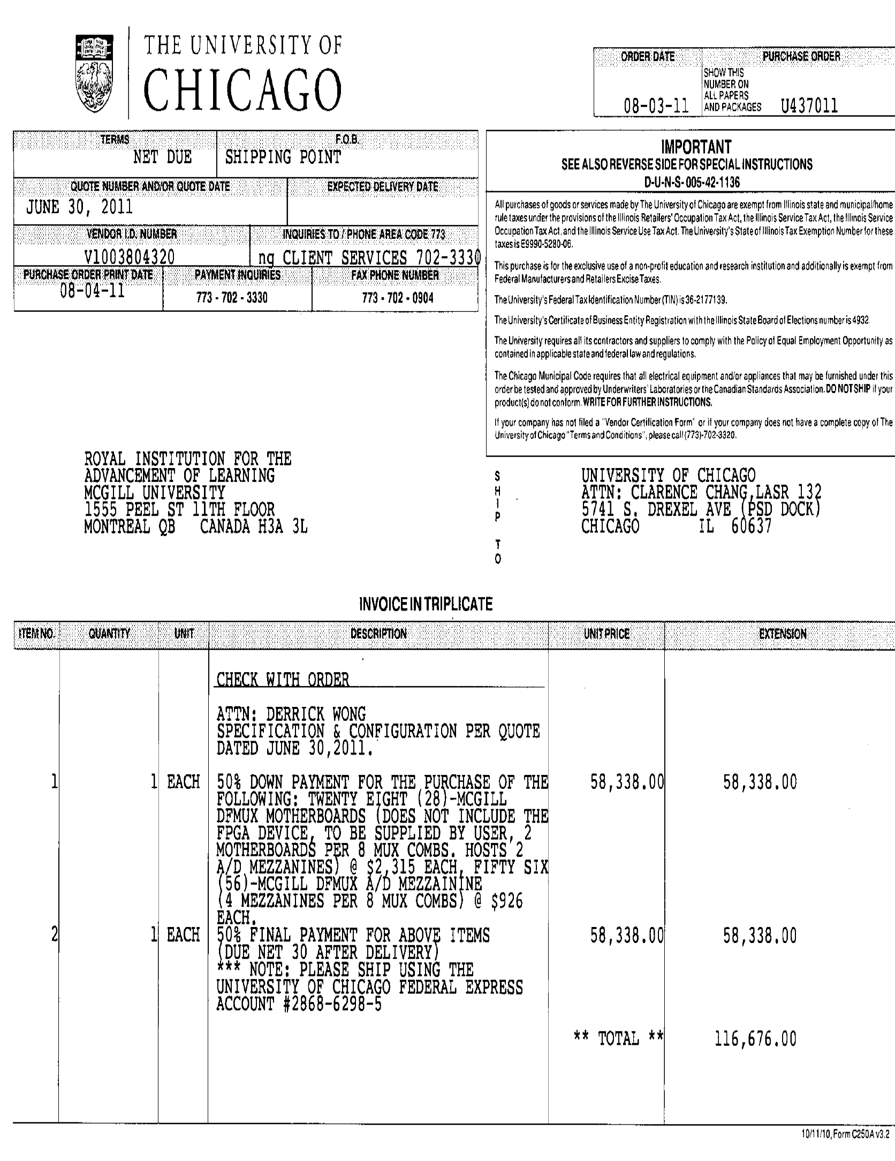
Example of a Manual Purchase Order (Front - Vendor)

Slide 18
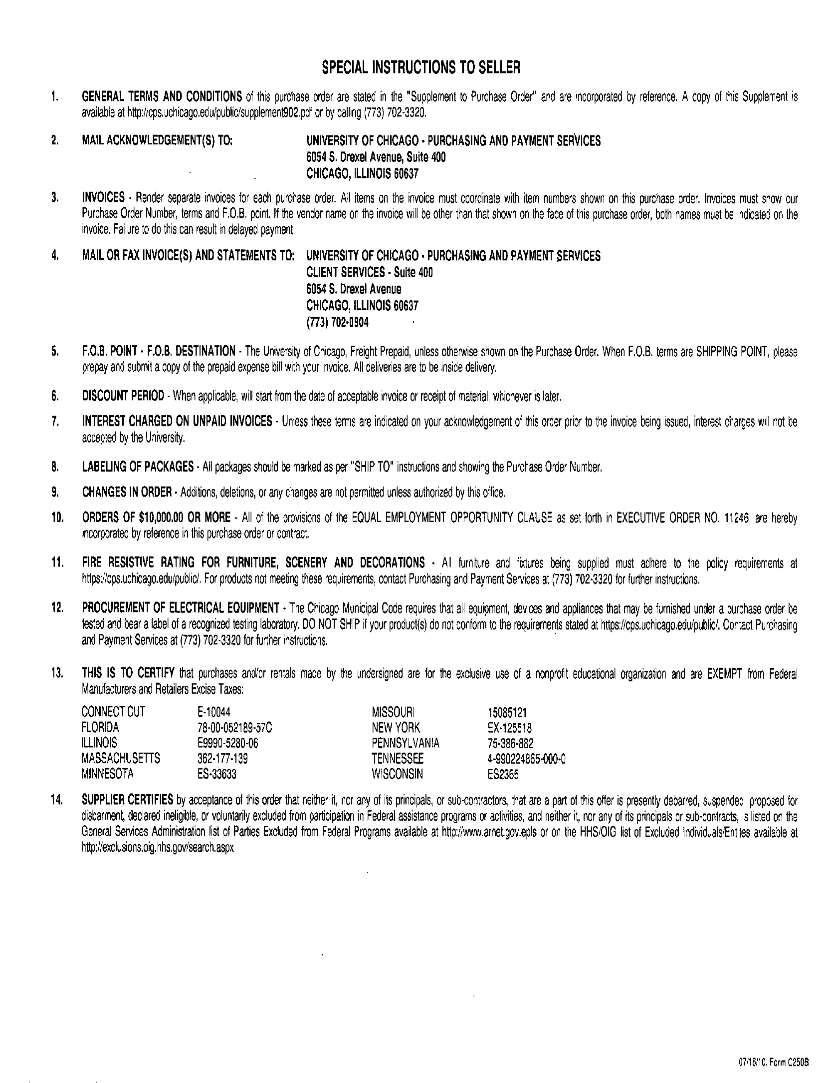
Example of a Manual Purchase Order (Back)

Slide 19
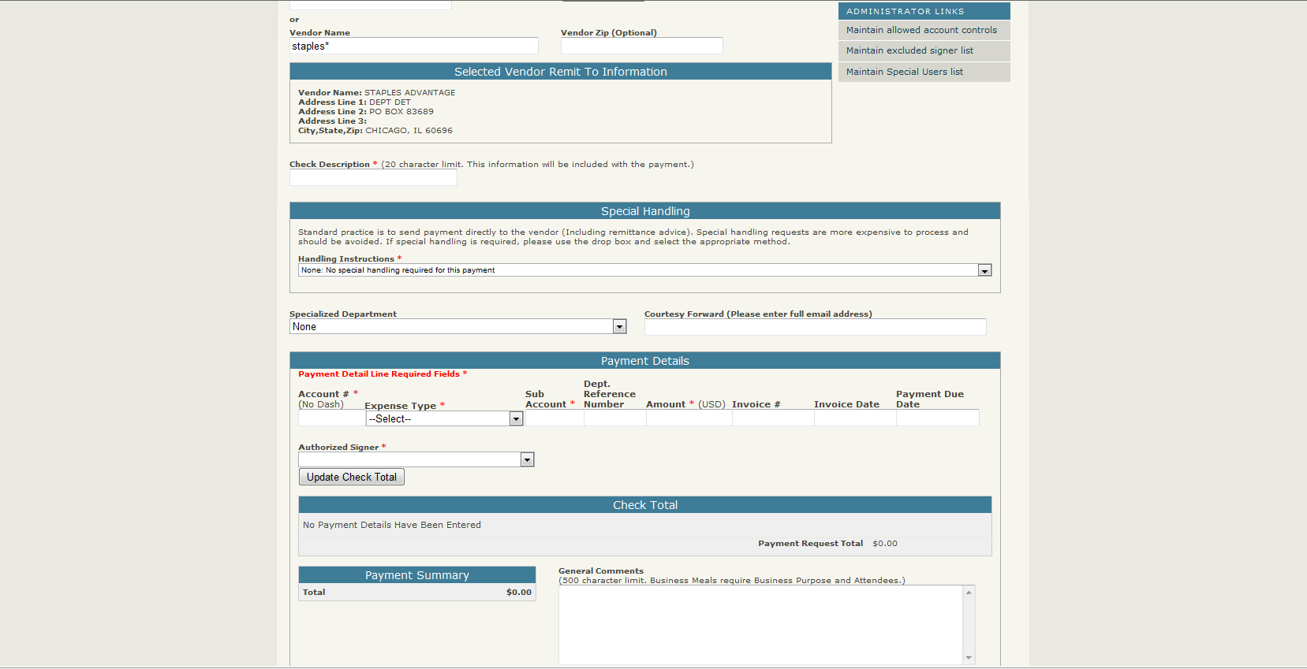
ePayment

Slide 20
General ePayment Guidelines
Ensure to use the vendor’s Remit To address from the invoice (this is the address where the payment is to be sent)
Only the actual invoice number should be entered into the “Invoice Number” field – do not enter account numbers or other information
“Mail with Enclosure” & “Hold at Bursar” should only be used when absolutely necessary – these require significant manual effort to pull checks out of the normal distribution process
Ensure to attach all supporting documentation required for processing the payment and documenting the business purpose

Slide 21
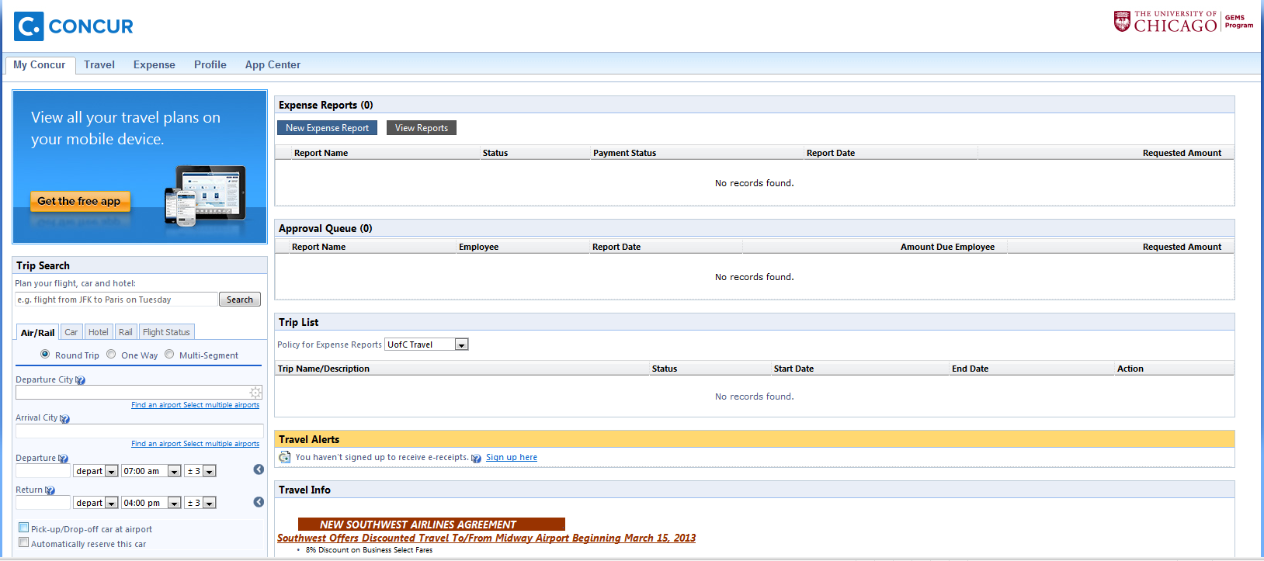
GEMS Program

Slide 22
General Expense Reimbursement Guidelines
All employee reimbursements must be processed through the GEMS system
All transactions must be accounted for in GEMS whether or not a receipt is required (e.g. - business purpose, date and amount)
Receipts are required for all expense of $75 or more
Exception: Receipts required for all “Business Meal” and “Hotel/Lodging” expenses regardless of dollar value (IRS requirement)
Receipts must sufficiently detail the item(s) that were purchased
Business Meal expenses must include the name of participants (if over 10 participants – list of groups attending is sufficient)
Proof of payment is required – receipt or bill must show that payment has been made
Restaurant check stubs (pull tabs) are not sufficient
Invoices without payment confirmation are not sufficient

Slide 23
Agenda
1
Purchasing and Payment within the University
2
Policy Overview
3
Purchasing Methods at the University
4
Purchasing Ethics
5
Useful Websites
6
Help References
7
Additional Training Opportunities

Slide 24
Purchasing Ethics
“As a basic condition of employment, all University staff employees have a duty to act in the University’s best interest in connection with matters arising from or related to their employment and other University activities.”
- Conflict of Interest Policy (U600)
Avoid conflicts of interest (even situations that cause a perception of conflict) – when unavoidable ensure you properly disclose to management. Some examples:
External activities or financial interests
Providing services to outside organizations with University time or resources
Family relationships with University suppliers
Maintain confidentiality of confidential information entrusted to you
Exercise good judgment in giving or receiving gifts or entertainment
“Disclosure is a key factor in protecting one’s reputation and career from embarrassing or harmful allegations of inappropriate conduct.”

Slide 25
Agenda
1
Purchasing and Payment within the University
2
Policy Overview
3
Purchasing Methods at the University
4
Purchasing Ethics
5
Useful Websites
6
Help References
7
Additional Training Opportunities

Slide 26
Useful Websites
Procurement and Payment Services Website
http://finserv.uchicago.edu/purchasing/index.shtml
Procurement and Payment Services Staff Directory
http://finserv.uchicago.edu/about/index.shtml
Procurement and Disbursement Policies
http://finserv.uchicago.edu/support/policies/
Preferred Supplier Contracts
http://finserv.uchicago.edu/purchasing/lookup/index.shtml
Preferred Purchasing Methods Matrix
http://finserv.uchicago.edu/purchasing/preferred/index.shtml
BuySite Program Website
http://finserv.uchicago.edu/purchasing/po/buysite.shtml
ePayment Website
http://finserv.uchicago.edu/purchasing/check/epayment.shtml
GEMS Program Website
https://gems.uchicago.edu/
UChicago Travel Website
http://finserv.uchicago.edu/purchasing/travel/index.shtml

Slide 27
Agenda
1
Purchasing and Payment within the University
2
Policy Overview
3
Purchasing Methods at the University
4
Purchasing Ethics
5
Useful Websites
6
Help References
7
Additional Training Opportunities

Slide 28
Other Sources of Help
Procurement and Payment Services Support:
PPS Website: http://finserv.uchicago.edu/purchasing/index.shtml
PPS Help Desk Phone: 773.702.3320
PPS Help Desk Email Support: pps@uchicago.edu
JPMorgan Chase (lost or stolen card)
Domestic: 800.316.6056
International: 847.488.3748

Slide 29
Agenda
1
Purchasing and Payment within the University
2
Policy Overview
3
Purchasing Methods at the University
4
Purchasing Ethics
5
Useful Websites
6
Help References
7
Additional Training Opportunities

Slide 30
Additional Training Opportunities
BuySite Fundamentals (Instructor Led)
https://training.uchicago.edu/course_detail.cfm?course_id=876
Introduction to BuySite (online)
http://hrservices.uchicago.edu/training/videos/BuySite/BuySite_00_Opening/
ePayment Request – Requestor and Approver Training (Instructor Led)
https://training.uchicago.edu/course_detail.cfm?course_id=1274
GEMS System – New User (Instructor Led)
https://training.uchicago.edu/course_detail.cfm?course_id=681
GEMS System – User Guide (online)
https://gems.uchicago.edu/resources/forms/GEMS_CTE_QuickStart.pdf
GEMS System – Concur Travel – Quick Reference Guide (online)
https://gems.uchicago.edu/resources/forms/UC%20Cliqbook%20Quick%20Reference%20Guide.pdf
GEMS System – Expense Reporting - Quick Reference Guide (online)
https://gems.uchicago.edu/resources/forms/GEMS_QuickRef.pdf

Slide 31
QUESTIONS & DISCUSSION
THANK YOU

